Slide 1
Speech Emotion Features Selection Based on BBO-SVM
Mayank Jasoria (2016B1A70703P)
Tussank Gupta (2016B3A70528P)
Akriti Garg (2016B4A70480P)
Naman Deep Srivastava (2016B4A70891P)

Slide 2

Introduction

Slide 3

Introduction
Speech - One of the most direct and natural way of human communication.
Emotional Information in voice.
Voice signal easier to capture than other physiological signals.

Slide 4
Introduction
Basis of emotion recognition - To extract useful features from speech signals.
Redundant characteristics due to increasing speech feature dimension affects the result of recognition.
Objective
To find a set of low dimensional and sufficient features to characterize the emotion contained in speech signal.
To reduce the processing time and improve the efficiency of recognition.

Slide 5
Approach
An optimization method based on BBO-SVM for invariant elements of set is proposed.
Utilizes BBO (Biogeography Based Optimization) algorithm to select and optimize the original feature set.
Uses cross-validation result of SVM as a standard for evaluating subset.
Iterative optimization of the original high-dimensional feature set to get the compressed feature subset

Slide 6
Biogeography Based Optimization: BBO

Slide 7
Biogeography Based Optimization - BBO
Study of the distribution of species and ecosystems in geographic space and through geological time.
Habitat Suitability Index (HSI) - Capacity of a habitat to support a selected species
indicates the appropriate species survival index.
Suitability Index Variables (SIVs) - Habitability is related to features such as rainfall, topography, soil quality, temperature, etc.
In general, HSI and number of species in that habitat are directly related.

Slide 8
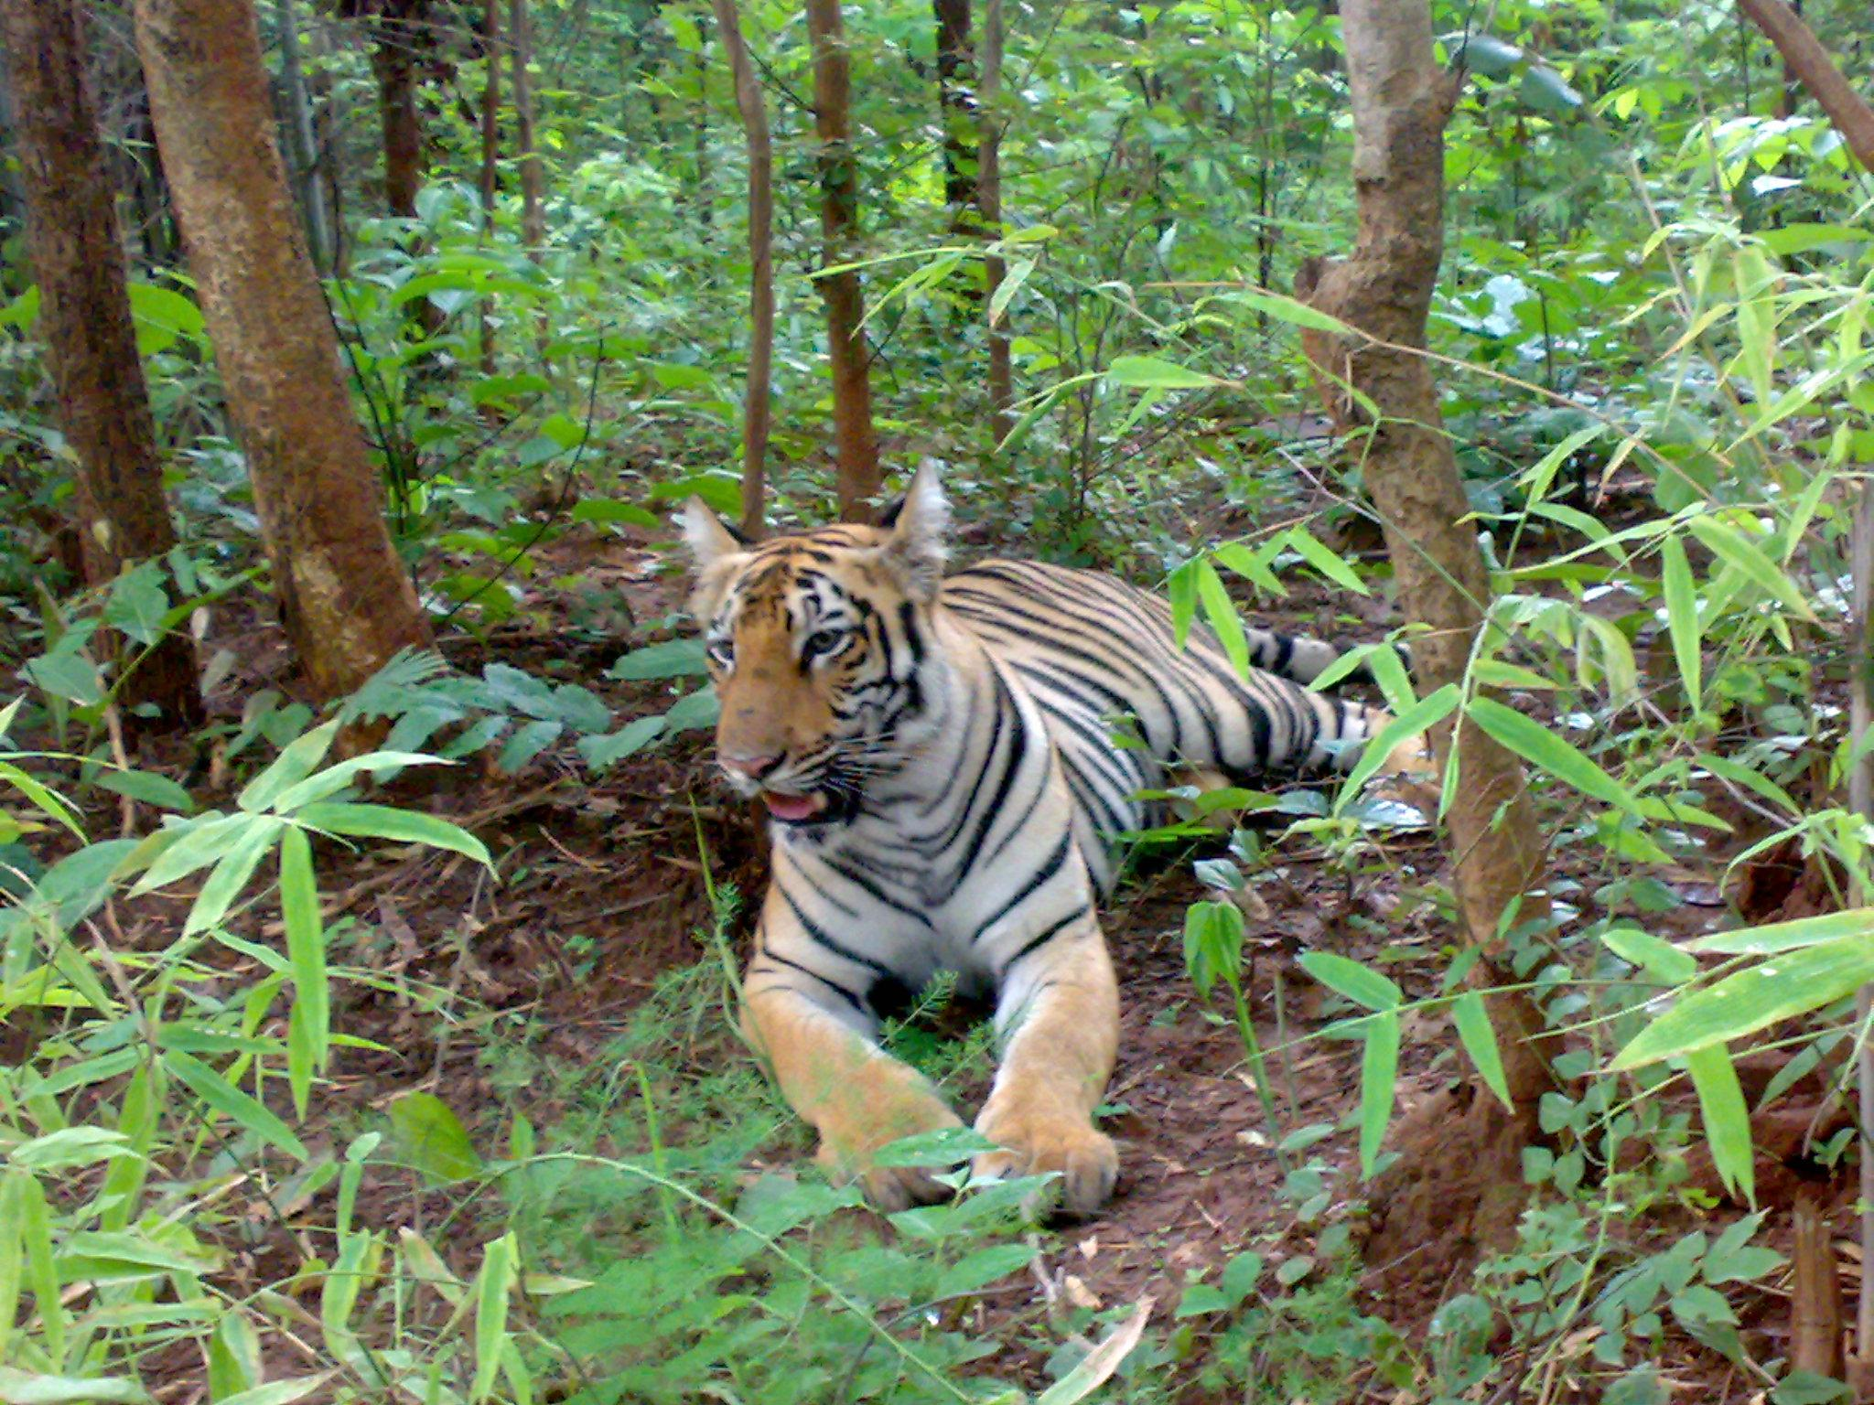
High HSI habitat
High Emigration Rate
Low Immigration Rate
Neighbouring habitats
Emigration
Immigration

Slide 9
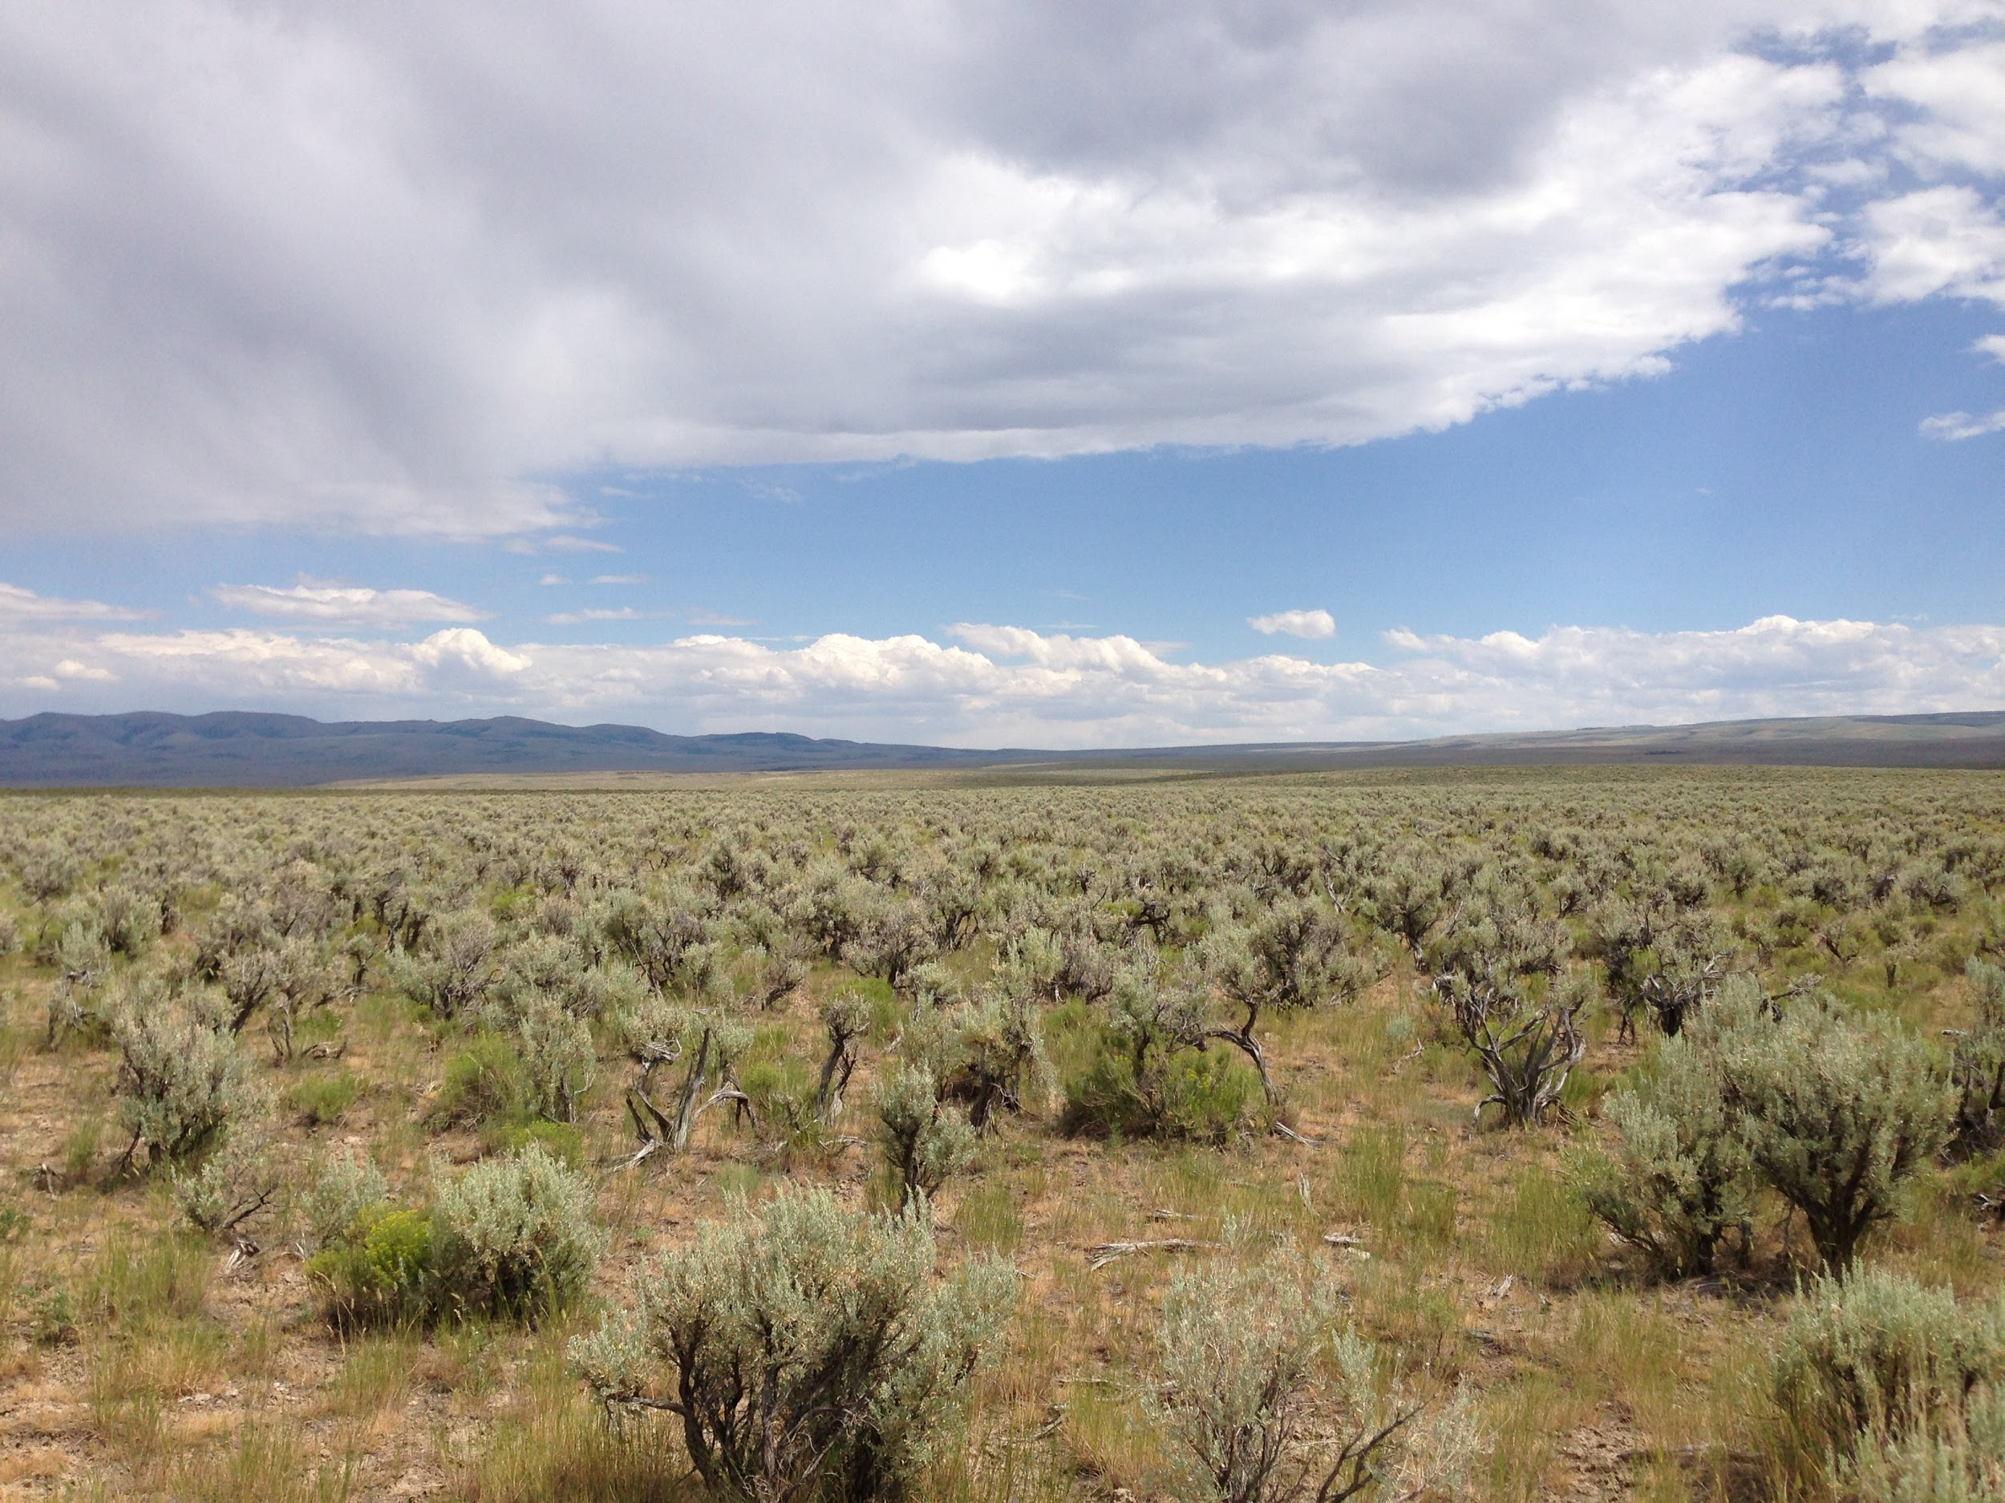
Low HSI habitat
High immigration rate
Low emigration rate
Neighbouring habitats
Immigration
Emigration

Slide 10
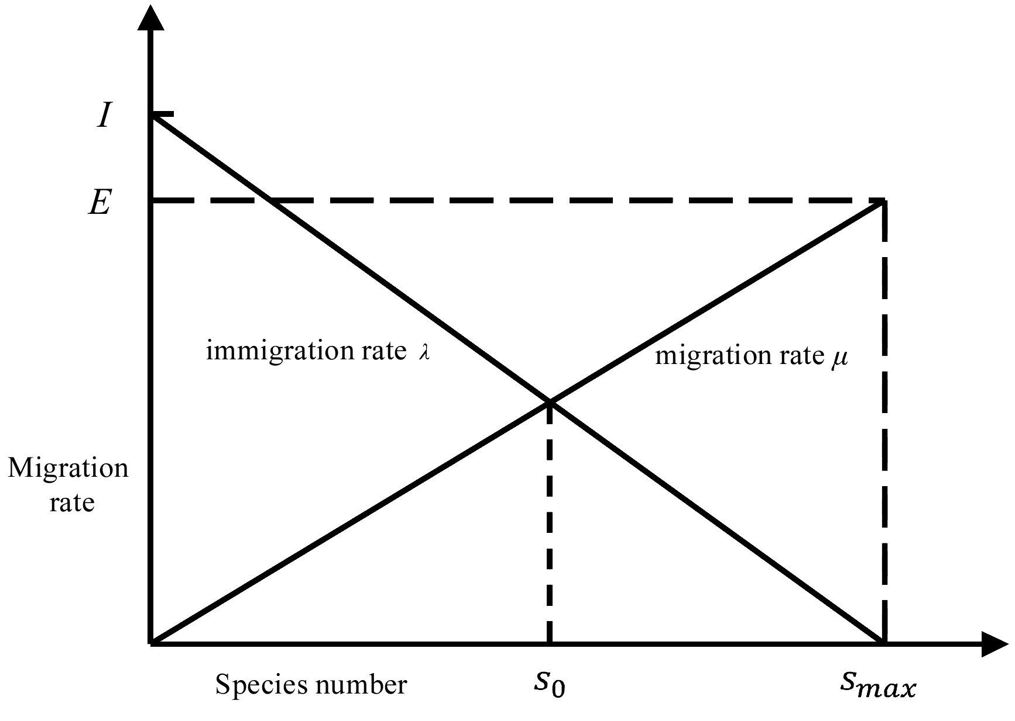
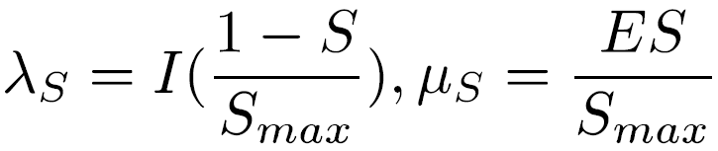
Simple Linear Mathematical Model
Both 𝝀 and 𝝁 are functions of the habitat species number S.
s₀ indicates the number of species in which the emigration rate and immigration rate reach equilibrium.
We can obtain following formula from this diagram,

Slide 11
BBO Algorithm
BBO is based on population, it regards
each solution of the population as a habitat
the goodness of the solution as the HSI of the habitat, and
each component of the solution as an SIV.
It can solve the optimization problem by stimulating the effect of migration and mutation in biogeography on population.

Slide 12
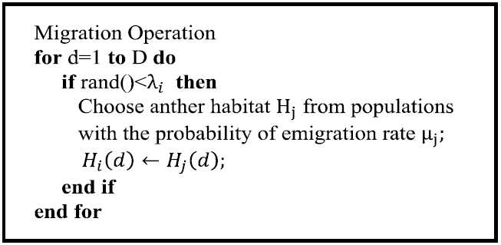
Migration Operation
Purpose- Transfer information between different solutions.
Optimal solution to other solutions.
Other solutions to the poor solution.
We select H_{i} with probability proportional to 𝜆_{i}
For each H_{i} , a solution H_{j} is selected with probability proportional to 𝜇_{j}
And then replace the current component of H_{i} with the corresponding component of H_{j}.
The algorithm compares the fitness of H_{i} and the new solution H_{i}’ and then keep a solution with higher fitness.

Slide 13
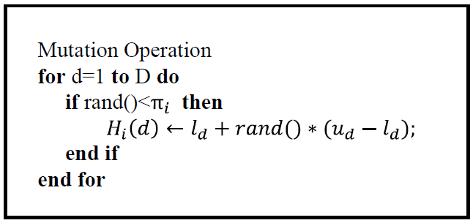
Mutation Operation
Unexpected events can change HSIs of natural habitats.
This situation modeled as SIV mutation in BBO algorithm.
The probability of species quantity is higher when number of species is medium.
Each solution H_{i} of the population is given an associated probability number of species P_{i}.
Based on this, each solution will have a probability π_{i} to mutate.
The value range of the D dimension of this problem is [l_{d}, u_{d}], assuming it to be a continuous optimization problem.

Slide 14
BBO-SVM Emotion Feature Selection Model

Slide 15
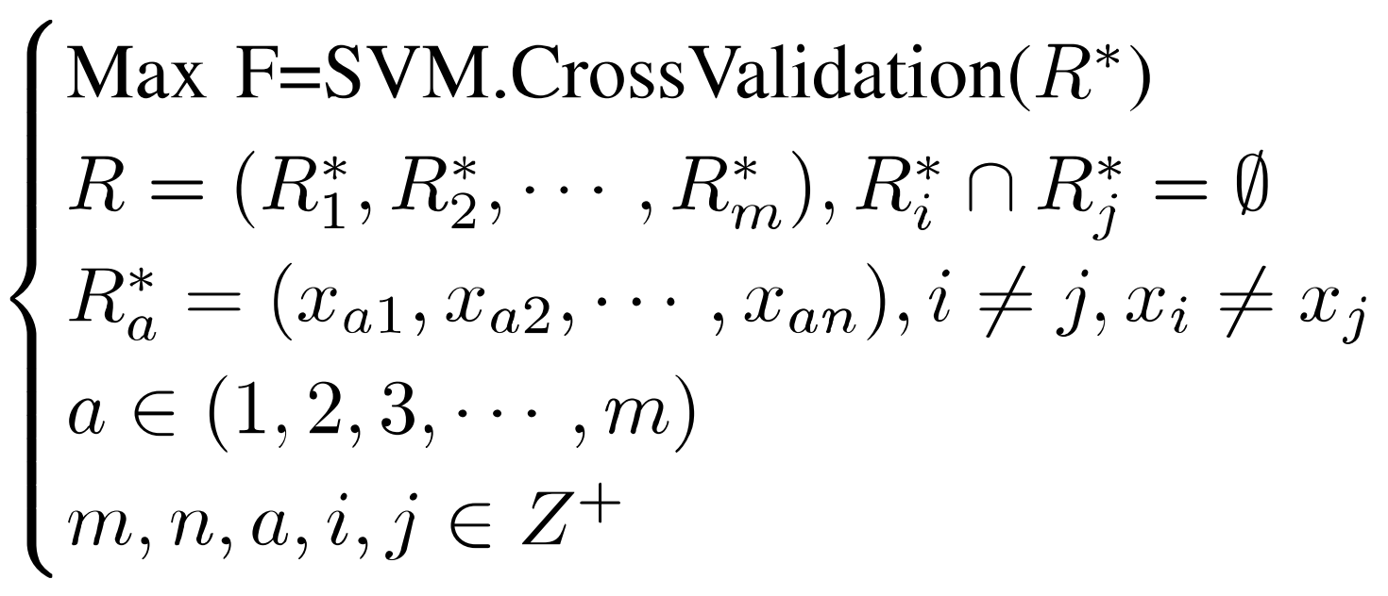
Design Idea
Goal: Select a subset of features that makes the emotion classification rate higher.
Selection of speech feature set transformed into an optimization problem:
Notes:
In this formula F is the result of cross validation result of support vector machines. It is the objective function to evaluating the optimization problem.
R is the original emotion feature set.
R_{a}* is a subset of the features obtained after partitioning R.
We use SVM because SVM has excellent learning performance, that is suitable for many classification problems.

Slide 16
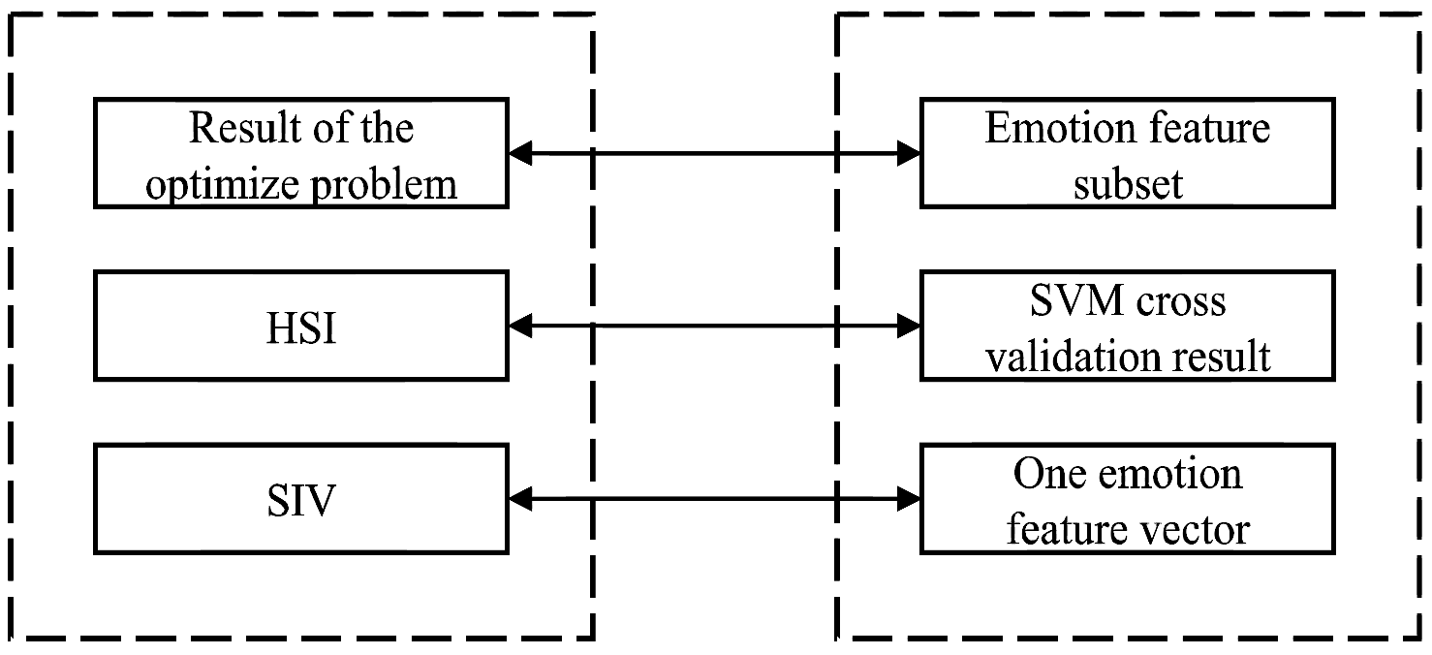
BBO Corresponds to Feature Selection Model
Finite iterative calculation gives optimal solution of the problem.
Optimal subset of emotion feature set.
During each iteration:
SVM cross validation result corresponds with HSI of geographical environment
Each vector corresponds to SIV of each habitat in the geographical environment.
Notes:
subset of the original feature sets corresponds to the solution of the BBO optimization problem.
by following the iterative procedure, we obtain the optimal subset of the emotion feature set.
During the iteration the results of the SVM cross validation for each subset correspond to the HSI of the geographical environment which also serves as the criteria to judge the subset of emotional features.
We want to remove the redundant feature information and retain the feature subset which greatly contributes to emotion recognition. In this process the specific values of the eigenvector should not be modified, So this process has retained the migration operation of the BBO Algorithm and removed the mutation operation as the mutation operation will change the SIV itself.

Slide 17
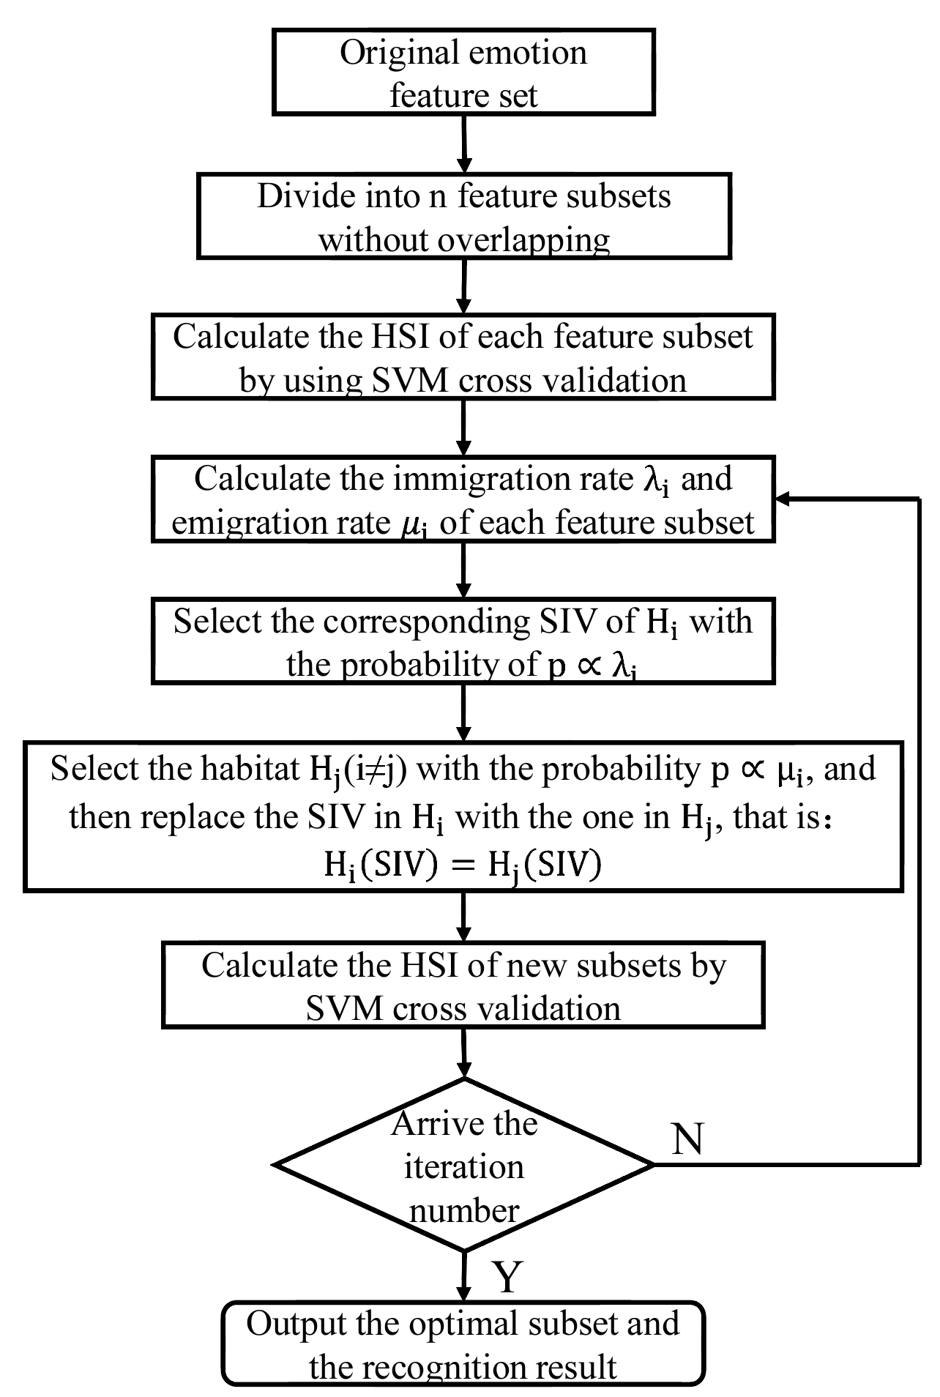
BBO Emotion Feature Selection Algorithm
Y
Notes:
Obtain the original feature set X by extracting the speech feature.
X is randomly divided into n subsets with equal number of features.
Then we calculate the HSI of each feature subset using the cross validation result of the SVM.
According to the result, the immigration rate and emigration rates are calculated.
Then we perform the migration operation fro which we select Hi with probability proportional to Lamba_i and select Hj with probability proportional to Mu_j and replace the SIV in Hi with the one in Hj.
Until we reach the maximum iteration number, we keep repeating this process and finally output the optimal subset and the recognition result.

Slide 18
Experimental Simulation

Slide 19
Data Sources and Preprocess
Berlin Emotional Speech Database
7 types of Emotions:
medium, happy, angry, sadness, disgust, boredom and fear.
This experiment chooses 40 audio files for each kind of emotion.
So, 280 audio files.
openSMILE used for speech signal feature extraction
It generates 1582 dimensional speech features.
SVM used to recognize emotions.

Slide 20
Simulation Experiment and Result
Parameter Initialization
This paper sets population size, N = 14
Number of feature vectors in each population, M = 113
50 is set as the maximum iteration number.
Maximum Emigration rate and Immigration rate are set to 1.
For comparison purposes, Genetic algorithm under the same parameter settings is selected.
Results were obtained using both BBO Algorithm and GA algorithm.

Slide 21
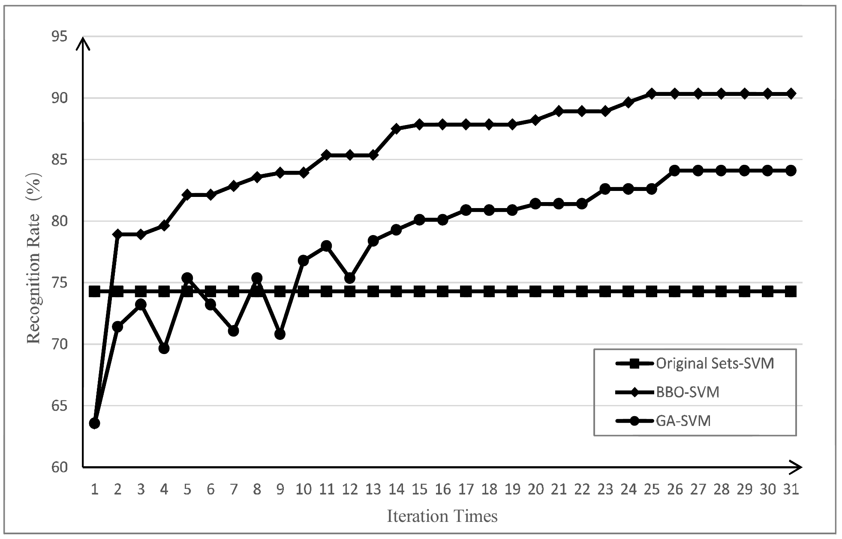
Notes:
This graph shows the change of emotion recognition rate of the optimal subset after each iteration. Initially, after the random allocation of the original feature subset, the recognition rate is below 65%. But, the BBO-SVM crosses 80% just after 5 iterations and in about 25 iterations the recognition rate for BBO-SVM reaches 90%. It clearly shows that the BBO-SVM is better than the GA-SVM.

Slide 22
Comparison of Recognition rate
Feature Sets | Max. Recognition Rate | Average Recognition Rate
Original - SVM | 74.29% | 74.29%
GA - SVM | 84.11% | 81.26%
BBO - SVM | 90.36% | 90.13%

Slide 23
Conclusion

Slide 24
Conclusion
The BBO-SVM algorithm can
Effectively reduce the dimensions of the original high dimensional collection and
Improve the accuracy of classification.
The recognition rate using optimized feature set can reach 90.4%.
BBO-SVM appears to be more effective compared to GA-SVM when simulation experiments under same conditions are compared.
There is a certain probability of eliminating an excellent feature - This loss can be serious.
Dynamic generation of subset with unfixed length might give better results.

Slide 25
Thank You

